Slide 1
Multi-Agent RL for the Wolf Sheep Game
Xiao’ao Song
Shahab Nikkhoo
Jun. 8, 2023

Slide 2

2
Outline
Game introduction
Environment
Rules and Objectives
Agents
Methodologies
Search algorithm
Supervised learning algorithm
Training data
Feature transformation
Reinforcement learning (RL) algorithm
Teacher-student framework
PPO
Final demonstration
Summary
Contribution and future work

Slide 3
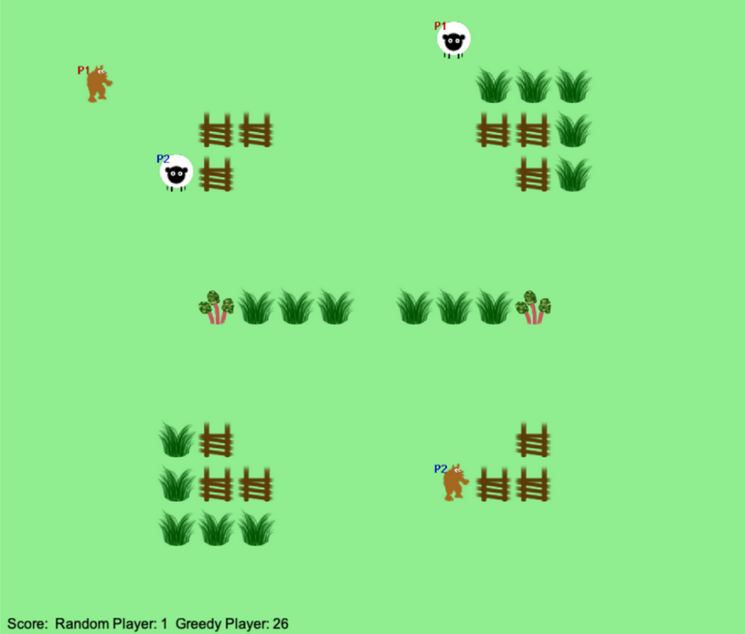
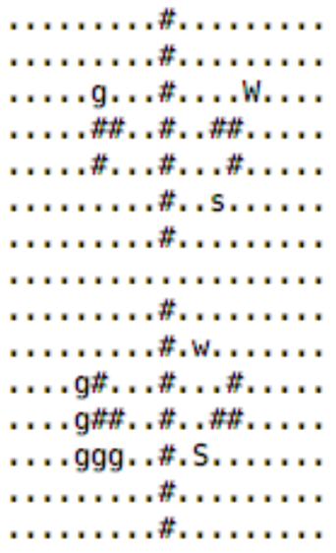
3
Game introduction - Environment
Environment: fully observable, dynamic, multi-agent
Map size: 15 x 19
Maps elements:
Empty "." Grass "g" Rhubarb "r" Fence "#”
4 Agents:
Player 1: Sheep (S), Wolf(W)
Player 2: sheep (s), wolf(w)
Action space: {up, down, left, right, none}
Map in matrix form
Map in RGB image form

Slide 4
4
Game introduction - Rules and Objectives
The Wolf moves for every second step of the sheep
Invalid move:
Move outside of the map or on the fence
Move on the grid where it is occupied
Valid move:
Consume or sabotage the food
Move to the empty grid
Wolf can eat enemy sheep by moving to its grid
Sheep Objectives:
Avoid the enemy wolf
Collect as many food as possible
Wolf Objectives:
Catch the enemy sheep
Block the enemy wolf
Sabotage the food

Slide 5
5
Game introduction – Default agents
Random player: moves randomly every turn
Keyboard player: moves by receiving your keyboard command
Passive player: stays in place every turn
Greedy player: uses a simply greedy approach. It includes the following helper functions:
get_player_position()
food_present()
valid_move()
closest_goal()
wolf_close()
run_from_wolf()
gather_closest_goal()
move_wolf()
move_sheep()
Credits to
Prof. Abraham Bernstein
Drawback of Greedy player
This project used the GUI from the DDIS group of the University of Zurich.

Slide 6
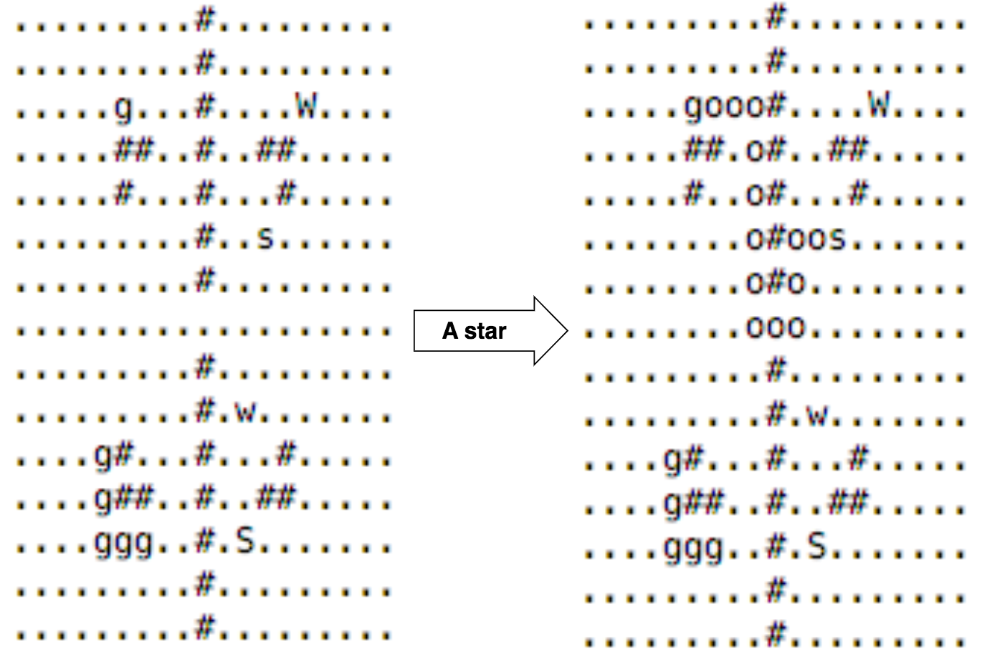
6
Methodologies – Search-based algorithm: A*

Slide 7
7
Methodologies – Search-based algorithm: A*
Greedy player
A* player

Slide 8
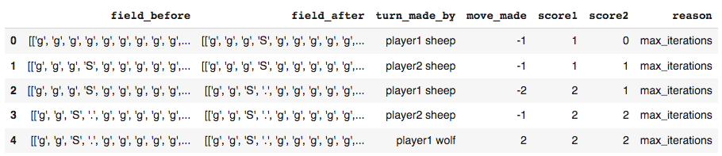
8
Methodologies – Supervised learning algorithm: MLP
Sample training data
In the context of supervised learning, we just need the following data to form (X , Y) pairs:
field_before: map before the move was made.
move_made: the actual move the agent made (e.g. -1).

Slide 9
9
Methodologies – Supervised learning algorithm: MLP
Due to limited computing resource, we preprocess the data to reduce the dimensionality of the data from high to low.
dim: 15 x 19 -> 1 x 16
Sheep features:
[sheep_fencing, sheep_stuckable, stay_preferable, food_available, path_available, move_up_closer, move_down_ closer, move_left_ closer, move_right_ closer, target_neighboring, up_walkable, down_walkable, left_walkable, right_walkable, stay_safeable, run_fromwolf]
Wolf features:
[sheep_stuckable, stay_preferable, path_available, move_up_closer, move_down_ closer, move_left_ closer, move_right_ closer, up_walkable, down_walkable, left_walkable, right_walkable]
Φ(input map) -> vector
dim: 15 x 19 -> 1 x 11
All of the above features only have value 1 or 0, e.g.:
Sample Sheep feature vector: [0, 0, 0, 1, 1, 1, 0, 0, 0, 0, 1, 0, 0, 0, 1, 1] and it takes action: UP
Sample Wolf feature vector: [0, 0, 0, 1, 1, 1, 0, 0, 0, 0, 1] and it takes action: NONE

Slide 10
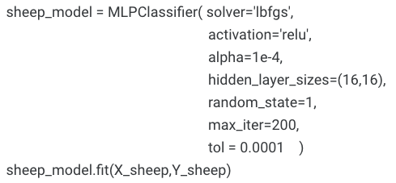
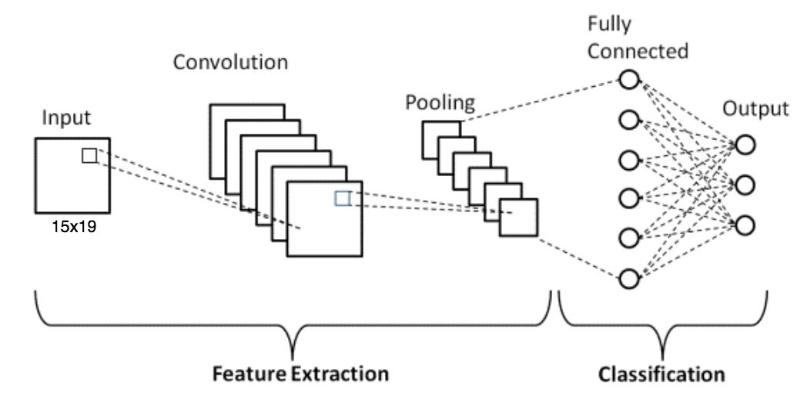
10
Methodologies – Supervised learning algorithm: MLP
Now, we can learn a simple network based on many ( Φ(X) , Y ) pairs:
We have our policy networks now!
A few notes on preprocessing:
We hand-craft features to reduce dimensionality, then train a simple MLP
However, they are totally learnable (e.g. CNN)
If no budget limit, one can use end-to-end learning without any preprocessing (a comparison is provided at the end).

Slide 11
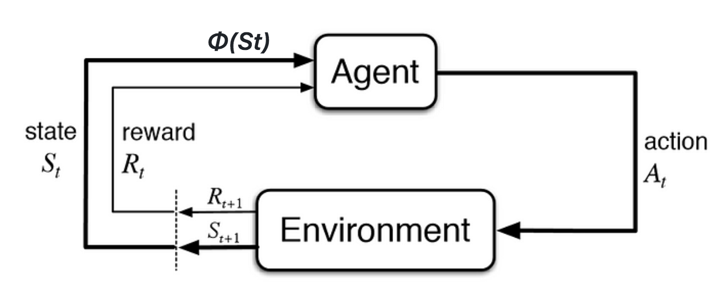
11
Methodologies – RL: PPO
In contrast to supervised learning, RL has no labels but learns from the rewards.
Proximal Policy Optimization (PPO) :
On-policy optimization algorithms.
Balance between sample efficiency and stability.
Robust to hyperparameter choices and often converges reliably.
Employs a surrogate objective function with a clipping mechanism to ensure stable updates
Notes:
is an algorithm used in reinforcement learning.
PPO is on-policy optimization algorithms.
balance between sample efficiency and stability.
PPO is robust to hyperparameter choices and often converges reliably.
Policy Optimization: PPO improves policies by iteratively updating their parameters.
Clipped Surrogate Objective: PPO employs a surrogate objective function with a clipping mechanism to ensure stable updates.

Slide 12
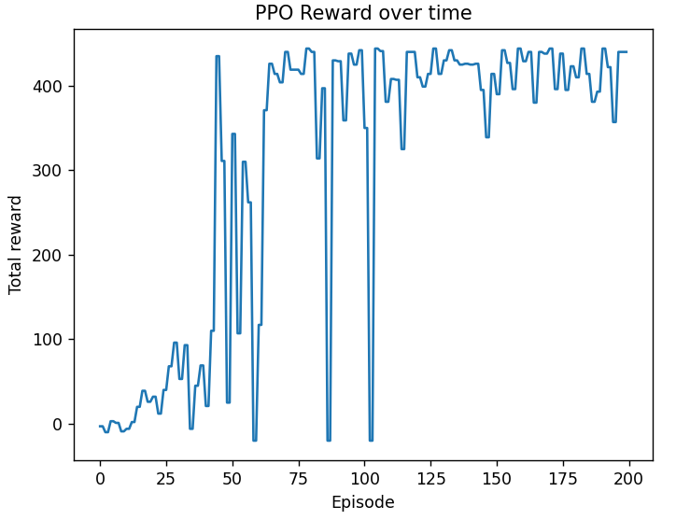
12
Methodologies – RL: PPO feature vector learning
Design the rewards (for Sheep)
Collect grass/rhubarb : +1 / +5; Trapping enemy sheep: +100; Each step: -0.2; Got eaten: -100
Input is 1 x 16 vector, output is a scalar
The learning process is fast and stable

Slide 13
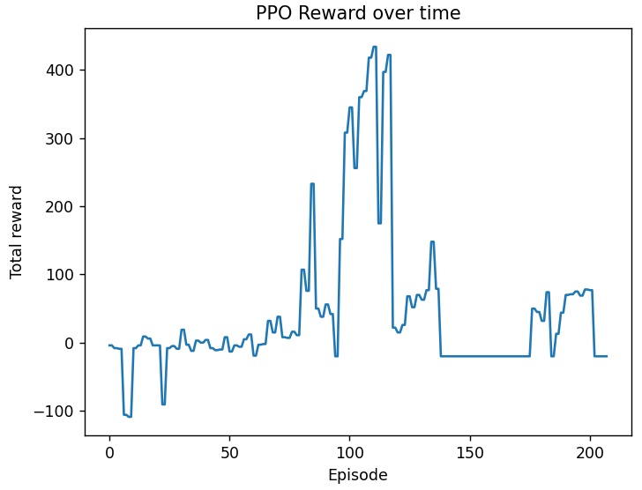
13
Methodologies – RL: PPO end-to-end learning
Design the rewards (for Sheep)
Collect grass/rhubarb : +1 / +5; Trapping enemy sheep: +100; Each step: -0.2; Got eaten: -100
Input map is 15 x 19 matrix output action is a scalar
The learning process is unstable and needs significant time

Slide 14
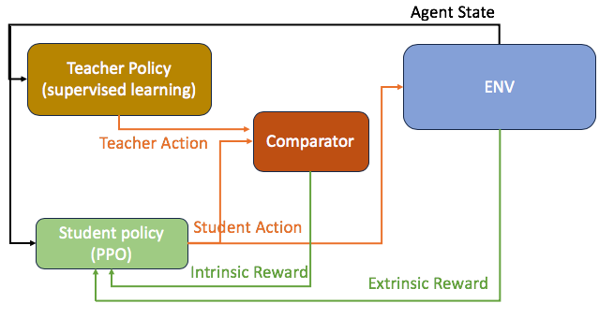
14
Methodologies – RL: teacher - student framework
In stead of doing everything from scratch, we can utilize the MLP model we get previously to guide our agent to learn. This is called teacher-student framework.
Re-design the rewards (for Sheep)
Intrinsic:
Student a == Teacher a : 0
Student a != Teacher a : -3
Extrinsic:
Collect grass/rhubarb : +1 / +5;
Trapping enemy sheep: +100;
Each step: -0.2;
Got eaten: -100
Teacher student framework diagram

Slide 15
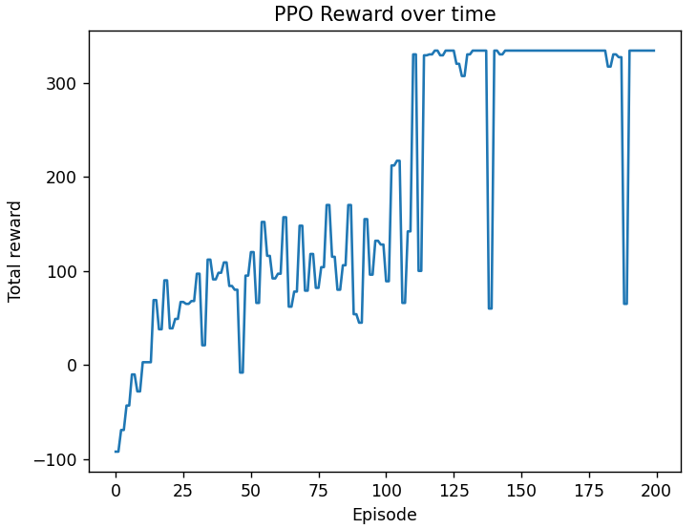
15
Methodologies – RL: teacher - student framework
Teacher Policy
has access to privileged data
informed trajectory based on A*
Student Policy
has access to map features
doesn’t have the best trajectory, only the closeness measure
Time efficient: fast learning process guided by teacher policy

Slide 16
16
Methodologies – RL: teacher - student framework
Ideal student policy will replicate the teacher policy
Teacher policy
Student policy

Slide 17
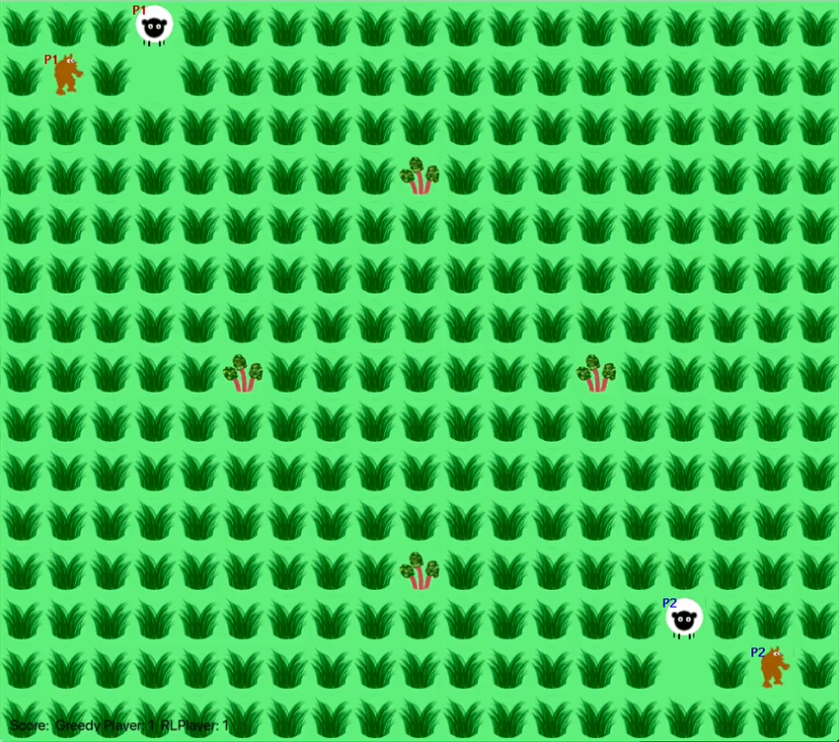
17
Final demonstration
Map 1
Full of food
Opponent agent:
Greedy player
Our agent:
RL player
Order:
Second move
Notes:
In this project, we made the following contributions:
Wrote the gym environment for the game so that it can be used for many existing RL algorithm packages.
Developed an agent based on Search Tree algorithm(A*) to play this game.
Use dimension reduction techniques to decrease the complexity of the game by transform the image to vector so that it can be learned fastly.
Developed an agent based on supervised learning algorithm(MLP) to play this game.
Developed an agent based on Reinforcement Learning algorithm(DDPG) to play this game.
Developed an agent based on Reinforcement Learning algorithm(Teacher-Student Framework) to play this game.
Tested our algorithms on different map to demonstrate its generalizability
In the future work, we will conduct the following aspects:
Learn an end-to-end model for the game where the input is the image and all the features will be extracted along the way instead of hand-crafted separately.
Learn one model for multi-agents (depends on the situation).
Test on more maps that contain some corner cases.

Slide 18
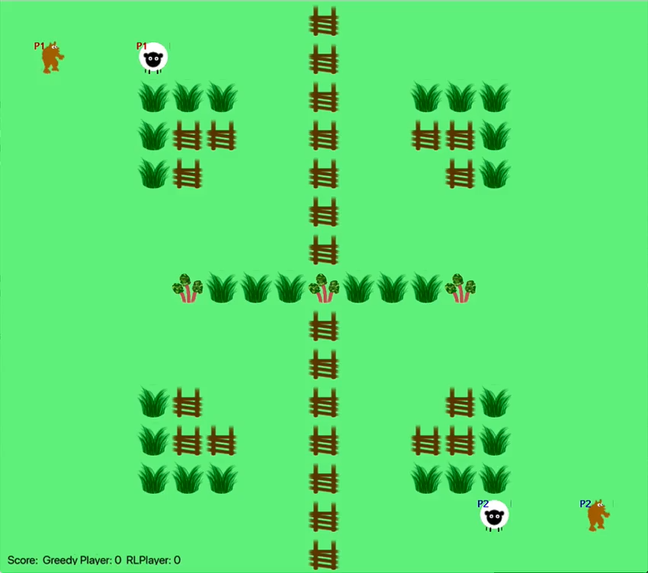
18
Final demonstration
Map 2
Fence in the middle
Opponent agent:
Greedy player
Our agent:
RL player
Order:
Second move
Notes:
In this project, we made the following contributions:
Wrote the gym environment for the game so that it can be used for many existing RL algorithm packages.
Developed an agent based on Search Tree algorithm(A*) to play this game.
Use dimension reduction techniques to decrease the complexity of the game by transform the image to vector so that it can be learned fastly.
Developed an agent based on supervised learning algorithm(MLP) to play this game.
Developed an agent based on Reinforcement Learning algorithm(DDPG) to play this game.
Developed an agent based on Reinforcement Learning algorithm(Teacher-Student Framework) to play this game.
Tested our algorithms on different map to demonstrate its generalizability
In the future work, we will conduct the following aspects:
Learn an end-to-end model for the game where the input is the image and all the features will be extracted along the way instead of hand-crafted separately.
Learn one model for multi-agents (depends on the situation).
Test on more maps that contain some corner cases.

Slide 19
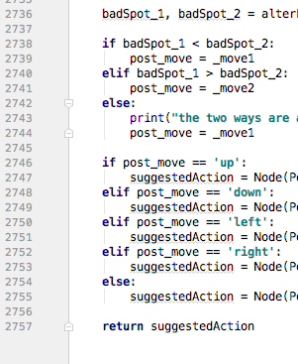
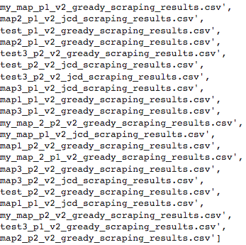
19
Summary
Search-based
Pros: rule-based, flexible
Cons: needs hand craft
Learning-based
Pros: no hand crafting
Cons: needs data
RL-based
Pros: no need to collect data
Cons: needs huge time to learn
At least 3h per training
Nearly 3000 lines of code!
At least 3~4k data samples!
Notes:
In this project, we made the following contributions:
Wrote the gym environment for the game so that it can be used for many existing RL algorithm packages.
Developed an agent based on Search Tree algorithm(A*) to play this game.
Use dimension reduction techniques to decrease the complexity of the game by transform the image to vector so that it can be learned fastly.
Developed an agent based on supervised learning algorithm(MLP) to play this game.
Developed an agent based on Reinforcement Learning algorithm(DDPG) to play this game.
Developed an agent based on Reinforcement Learning algorithm(Teacher-Student Framework) to play this game.
Tested our algorithms on different map to demonstrate its generalizability
In the future work, we will conduct the following aspects:
Learn an end-to-end model for the game where the input is the image and all the features will be extracted along the way instead of hand-crafted separately.
Learn one model for multi-agents (depends on the situation).
Test on more maps that contain some corner cases.

Slide 20
20
Contribution and future work
Wrote the gym environment for the Wolf-sheep game.
Developed Search-based, Supervised learning-based and RL-based agents.
Tested our agents in multiple unseen maps.
In future work:
Learn end-to-end model to process high-dimensional data directly.
Learn one model for multi-agents (depends on the situation).
Test on more maps that contain some corner cases.
Notes:
In this project, we made the following contributions:
Wrote the gym environment for the game so that it can be used for many existing RL algorithm packages.
Developed an agent based on Search Tree algorithm(A*) to play this game.
Use dimension reduction techniques to decrease the complexity of the game by transform the image to vector so that it can be learned fastly.
Developed an agent based on supervised learning algorithm(MLP) to play this game.
Developed an agent based on Reinforcement Learning algorithm(DDPG) to play this game.
Developed an agent based on Reinforcement Learning algorithm(Teacher-Student Framework) to play this game.
Tested our algorithms on different map to demonstrate its generalizability
In the future work, we will conduct the following aspects:
Learn an end-to-end model for the game where the input is the image and all the features will be extracted along the way instead of hand-crafted separately.
Learn one model for multi-agents (depends on the situation).
Test on more maps that contain some corner cases.

